Slide 1
Velsanet AI White Paper

Slide 2
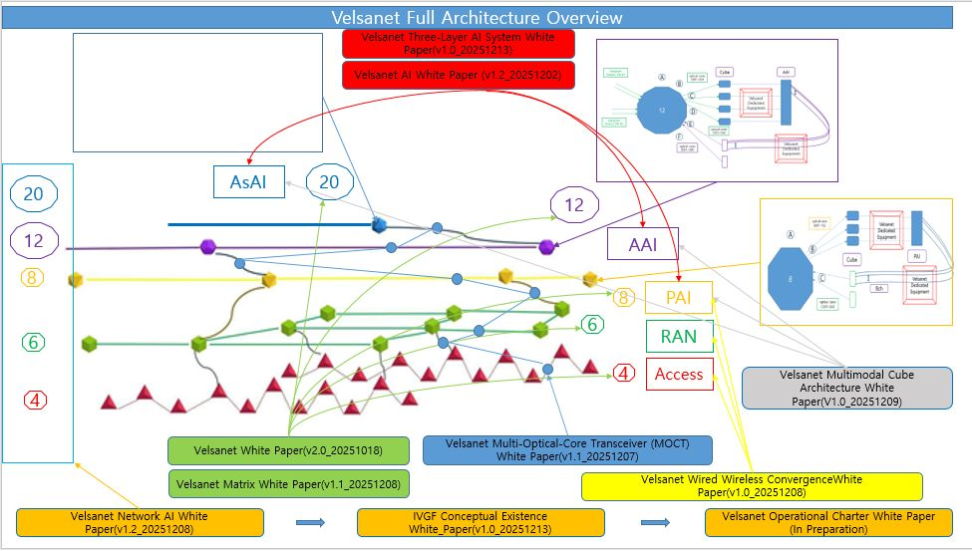

Slide 3
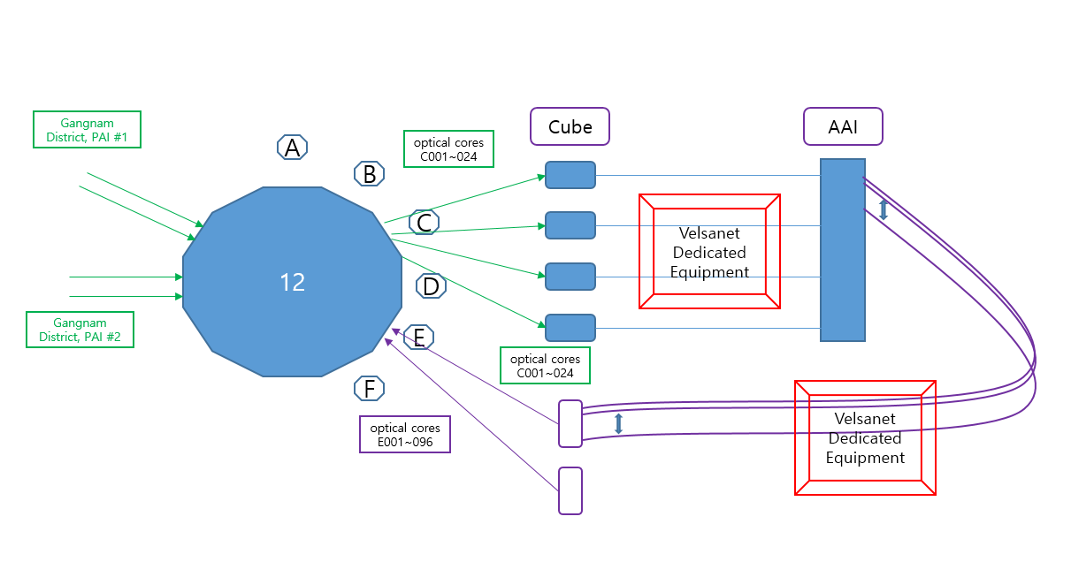
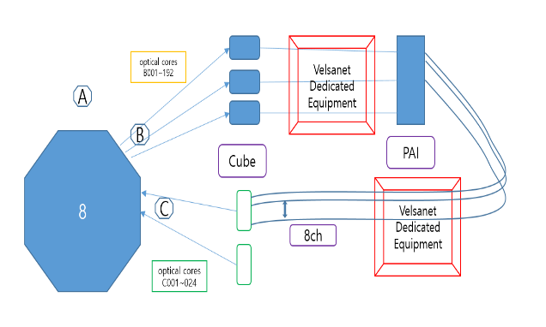
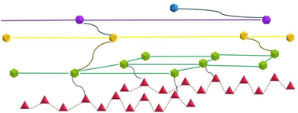
Velsanet Full Architecture Overview
Velsanet Three-Layer AI System White Paper(v1.0_20251213)
Velsanet AI White Paper (v1.2_20251202)
AsAI
20
20
12
12
AAI
8
8
PAI
6
RAN
6
4
Access
Velsanet Multimodal Cube Architecture White Paper(V1.0_20251209)
4
Velsanet White Paper(v2.0_251018)
Velsanet Multi-Optical-Core Transceiver (MOCT) White Paper(v1.1_20251207)
Velsanet Matrix White Paper(v1.1_20251208)
Velsanet Wired Wireless ConvergenceWhite Paper(v1.0_20251208)
Velsanet Network AI White Paper(v1.3_20251222)
IVGF Conceptual Existence White_Paper(v1.0_20251213)
Velsanet Operational Charter White Paper (In Preparation)
Velsanet Mathematical White Paper(v1.0_20251221) / Velsanet Spatial Genesis White Paper(v1.0_20251221)

Slide 4
Velsanet Dedicated Equipment
optical cores B001~192
A
B
8
PAI
Cube
Velsanet Dedicated Equipment
C
8ch
optical cores C001~024
PAI

Slide 5
Gangnam District, PAI #1
Cube
AAI
A
optical cores C001~024
B
12
Velsanet Dedicated Equipment
C
D
Gangnam District, PAI #2
E
optical cores C001~024
F
Velsanet Dedicated Equipment
optical cores E001~096
AAI

Slide 6
Core1 : Public E2E Optical Core(TCC excluded)
Disaster Alert
– Emergency audio warnings & evacuation guidance
Fire Safety
– Fire detection and direct fire department linkage
Security / Police
– Surveillance cameras and police response linkage
Emergency Call
– Direct emergency phone service (112 / 119)
Public TV Broadcast
– Disaster and public information broadcasting
Safety Status
– Intrusion and abnormal situation signals
Environmental Status
– Gas, smoke, flood, and hazard detection
Core 2: PAI-dedicated Optical Core
PAI Device
(Optical-to-8 Wireless Channel Mapping)

Slide 7
City E2E State Definition Layer
Emergency Override & Exception Control Room
City E2E Orchestration Room
District / Block E2E Federation Room
PAI Connectivity & Mapping Room
Public E2E Channel Control Room
ODF Room (Optical Distribution Frame Room)
Public E2E Channel Control Zone

Slide 8
Velsa (Network_AI)
Velsa_20 (Network_AI)
Velsa_20 (Network_AI)
Velsa_20 (Network_AI)
Velsa_20 (small Q: Q3–Q4)
Velsa_12 (Network_AI)
Velsa_12 (Network_AI)
Velsa_12 (Network_AI)
Velsa_12 (Network_AI)
Velsa_12 (medium Q: Q4–Q6)
Velsa_8 (Network_AI)
Velsa_8 (Network_AI)
Velsa_8 (Network_AI)
Velsa_8 (Network_AI)
Velsa_8 (large Q: Q6–Q8)

Slide 9
Network AI (8,12,20)
Ultra-fine mechanical contacts connected to the matrix
AI-Driven Topology Plane
Matrix control contact
Multi-Layer Multi-Plane Matrix
Polymer-form access optical cores
Parallel-configured multi-optical transceiver
Length: 5 meters or more

Slide 10
Ultra-fine mechanical contacts connected to the matrix
Parallel-configured multi-optical transceiver
Polymer-form access optical cores
Length: 5 meters or more

Slide 11
Through-Layer Via Structure
Switching Node
Face-to-Face Switching Fabric
B
C
C
D
D
D
E
E
E
E
MEMS
F
F
F
F
F
A
G
G
G
G
G
G
Fixed Optical Core
Multi-Core Optical Transceiver
H
H
H
H
H
H
28
7
+
6
+
5
+
4
+
3
+
2
+
1
28
(N(N-1))/2 , N=8

Slide 12
For the Velsanet MOCT architecture,
the polymer-based optical structure connected to the transceiver must be manufactured directly in a ribbon format.
This means the transceiver output, the polymer waveguide array, and the ribbon optical-core layer should form one integrated, planar optical structure—
without converting a round cable into a ribbon later.
This “native ribbon” design ensures precise alignment, low loss, and true parallel E2E connectivity across the multi-layer, multi-plane matrix.
MAI — MEMS Alignment Interface
Parallel Polymer-Based Optical Transceiver
Ribbon Optical-Core Layer
Ribbon Optical-Core
Fixed Multi-Core Optical Fiber Assembly (5m+ Factory-Attached)
Multi-Layer Multi-Plane Matrix
Multi-Layer Ribbon Fiber Coupling System (MLRFCS)

Slide 14
AI- native 의 시기적 변화에 대한 개념도
C-Overlay
AI-Overlay
AI
Net
work
Access
Network
Network
Network
RAN
Core
~2022
2023~2025
2026~
AI-Native Network Fabric
Velsanet(AI-Native Network)

Slide 15
Agent-Centered AI System Diagram
Assistant
Personal
Personal
Agentic Design Patterns
Agent
Personal
AI
Personal

Slide 16
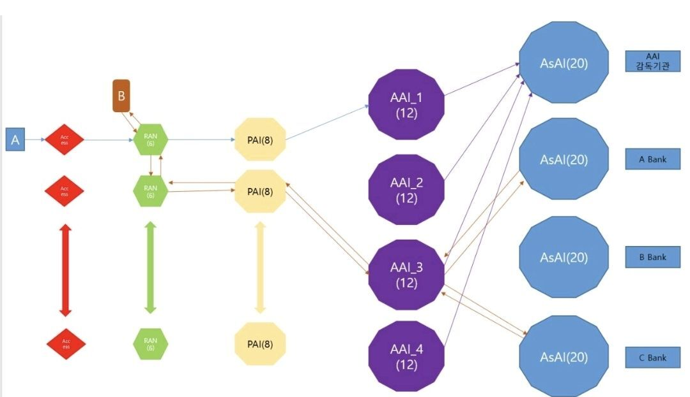
Role-Based AI Architecture

Slide 18
Present State
Past Experience 1
Past Experience 2
Past Experience N
Meta Layer
Encoding (Axis-based)
Axis-based Retrieval
Multimodal Perception
Future Candidate Generation Engine
Intent
Signal
Information
Dynamic Axis Weighting

Slide 19
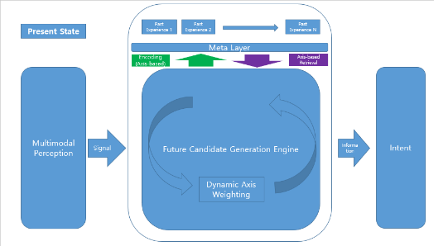
Policy Axis
Ethics Axis
Collective Intelligence Axis
Meta Layer( Delegation Mediation Agent)
Intent Framing
Axis-based Mediation
Delegation Mediation Agent
Intent mediation through contextualized knowledge
Normative alignment across policy, ethics, and collective intelligence
Intent
AAI(Agent AI)
Information
normative alignment
Knowledge
PAI

Slide 20
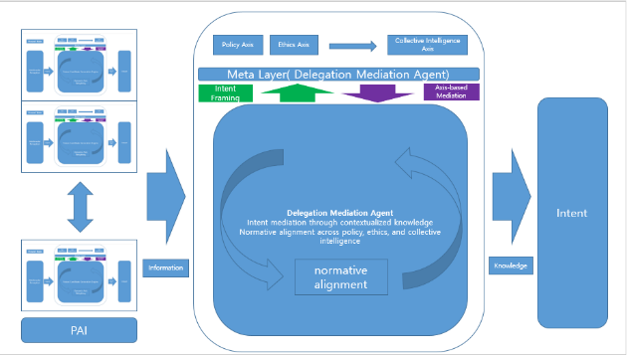
Organic growth represents intelligence that refines behavior through contextual understanding rather than predefined rules.
Context Awareness
Meta Layer (Execution Context Mediation)
Timing Judgment
Knowledge-based Execution Framing
Contextual Adaptation
Proportionality
Wisdom-based Execution Agent
Execution of knowledge-formed intent
through contextual adaptation and situational judgment
AsAI (Assistant AI)
Trade-off Handling
Execution Framing
Human Sensitivity
Failure Tolerance
Knowledge
Learning-in-Action
Situational Judgment
Responsibility Localization
Silence as an Option
AAI(Agent AI)

Slide 21
Conceptual / Structural Perspective Diagram
Boundary & Governance
Structural Boundary
Embedded Validation & Attribution
Intent & Symbol Handling
Intent Structuring
Symbolic Circulation
Execution Architecture
Parallel E2E Independence
Stability & Time
Failure Absorption
Asynchronous Time & State
Complete Ring = Meaning Preservation Zone
Closed Invariant Loop
(Structure for Meaning, Intent, and Continuity)
Outer Curves = Execution, System Expansion, and Environmental Interaction
Intent Recirculation and Structural Feedback
Arrows = State Transitions
Intent · Symbols · Meaning
(Structured Inputs to the Loop)
Coherent Actions · Decisions · Commitments
(Structurally Constrained Outputs)

Slide 22
Conceptual / Structural Perspective Diagram
Boundary & Governance
Structural Boundary
Embedded Validation & Attribution
Intent & Symbol Handling
Intent Structuring
Symbolic Circulation
Execution Architecture
Parallel E2E Independence
Stability & Time
Failure Absorption
Asynchronous Time & State
Complete Ring = Meaning Preservation Zone
Closed Invariant Loop
(Structure for Meaning, Intent, and Continuity)
Outer Curves = Execution, System Expansion, and Environmental Interaction
Intent Recirculation and Structural Feedback
Arrows = State Transitions
Intent · Symbols · Meaning
(Structured Inputs to the Loop)
Coherent Actions · Decisions · Commitments
(Structurally Constrained Outputs)

